Slide 1

Data Analysis of TikTok Posts
SC1015 MINI PROJECT
LAB GROUP: ECDS
Lily Ulfa Binte Anuar (U2430835D)
Du Ruiyang (U2430844L)
Lim Jing Ping (U2430278J)

Slide 2

Context
Social media marketing uses platforms like Tiktok to boost sales and expand reach.
As of early 2023, 4.76 billion users (59% of the world population) use social media.
500M+ of the 4.76 billion social media users are active users of Tiktok, offering high engagement and marketing potential that help boost sales.
Practical motivation

Slide 3


How do various posting
factors affect the
engagement of a
TikTok post?

Slide 4
Problem Definition
Goal: Analyze the different factors that affect TikTok engagement, measured by the number of likes a video receives.
Likes are a passive sign of interest from users.
Insights help refine strategies to increase engagement of target audience
Higher engagement = Higher conversion = Higher revenue
Dataset used:
TikTok - Posts.csv
Problem formulation

Slide 5
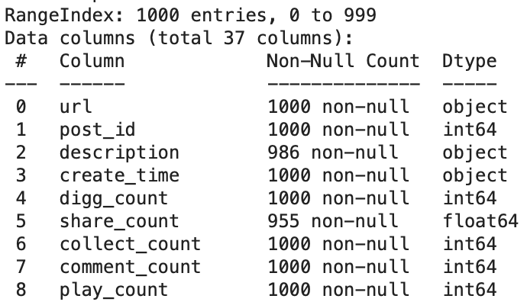
Exploratory Data Analysis
Number of rows: 1000
Number of columns: 37
- 3 Boolean variables
- 12 Numeric variables
- 22 Categorical variables
Numerical variables:
create_time, digg_count, play_count, video_duration, profile_followers
Categorical variables:
is_verified, weekday, Duration Category, Followers Category
Exploratory analysis

Slide 6
Exploratory Data Analysis
ANALYSIS DONE:
Distribution analysis of numerical variables using boxplots, histograms and violin plots, and correlation analysis
Analysis of catergorical variables using bar charts and boxplots
Exploratory analysis

Slide 7
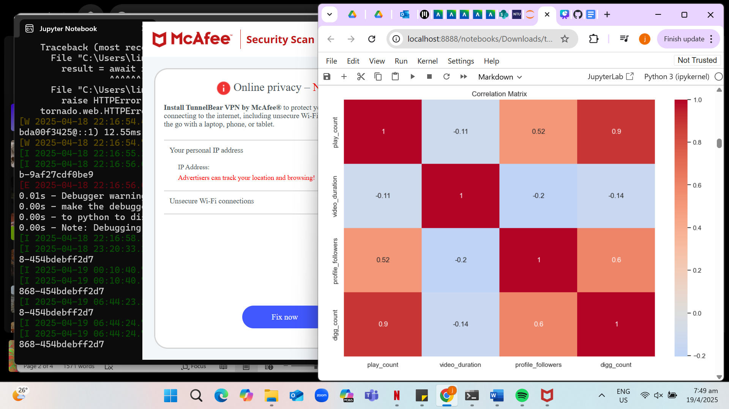
Correlation matrix for numerical variables
Highest correlation between play_count and digg_count
Lowest correlation between video_duration and digg_count
Statistical description

Slide 8
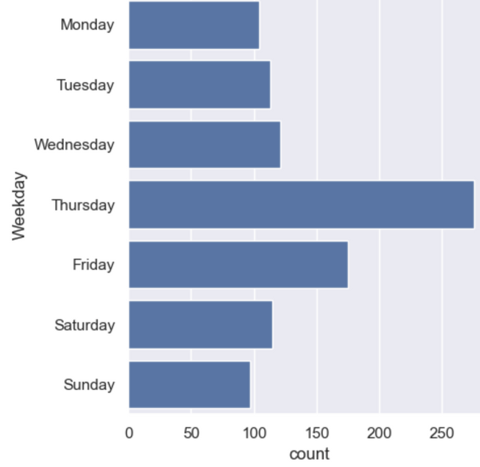
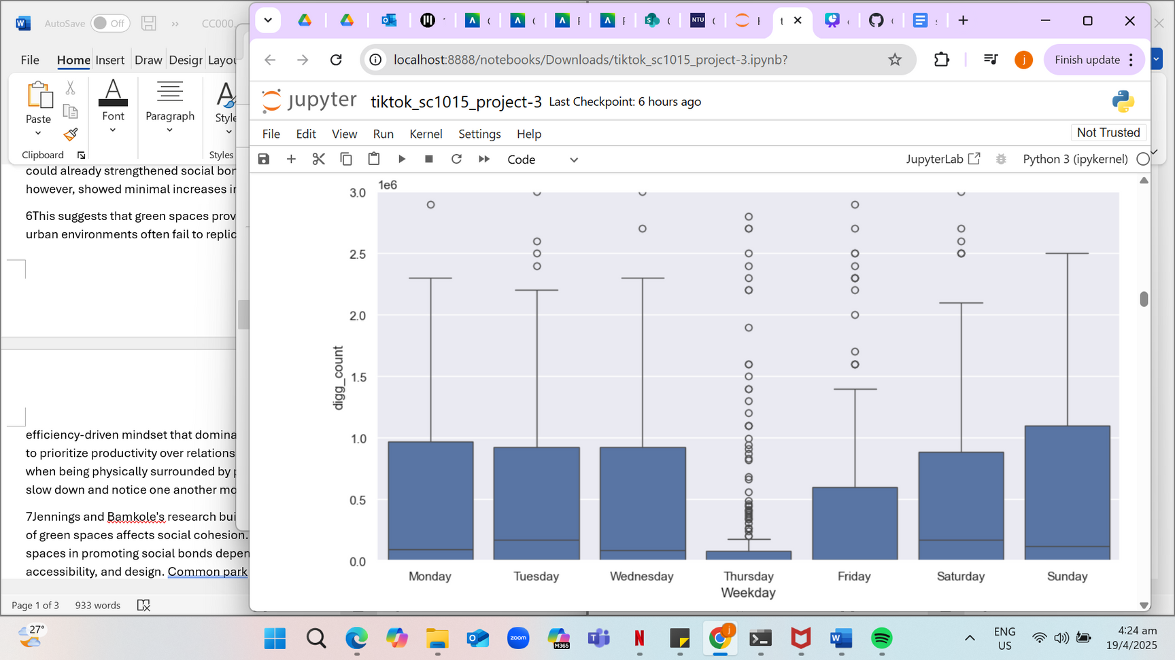
Number of posts for each day of the week
digg_count against day of the week
Median of digg_count across the days is relatively consistent except a significant decrease for Thursday and Friday.
Saturday and Sunday appear to have the highest median.
Statistical description

Slide 9
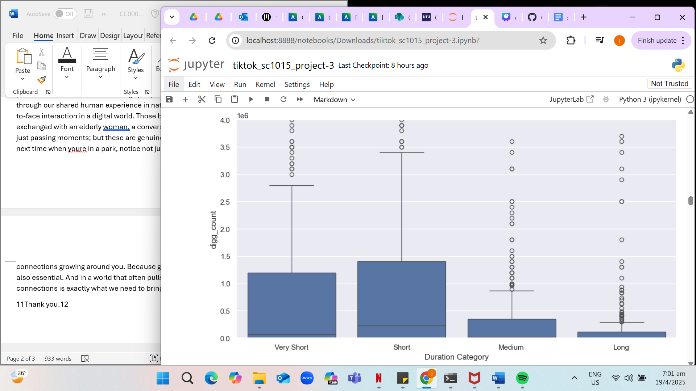
digg_count against duration category
Categorisation of video_duration ⟶ duration_category
Medium and long videos generate significantly lesser likes
Very short videos also generate lesser likes than short videos [smaller median]
Statistical description

Slide 10
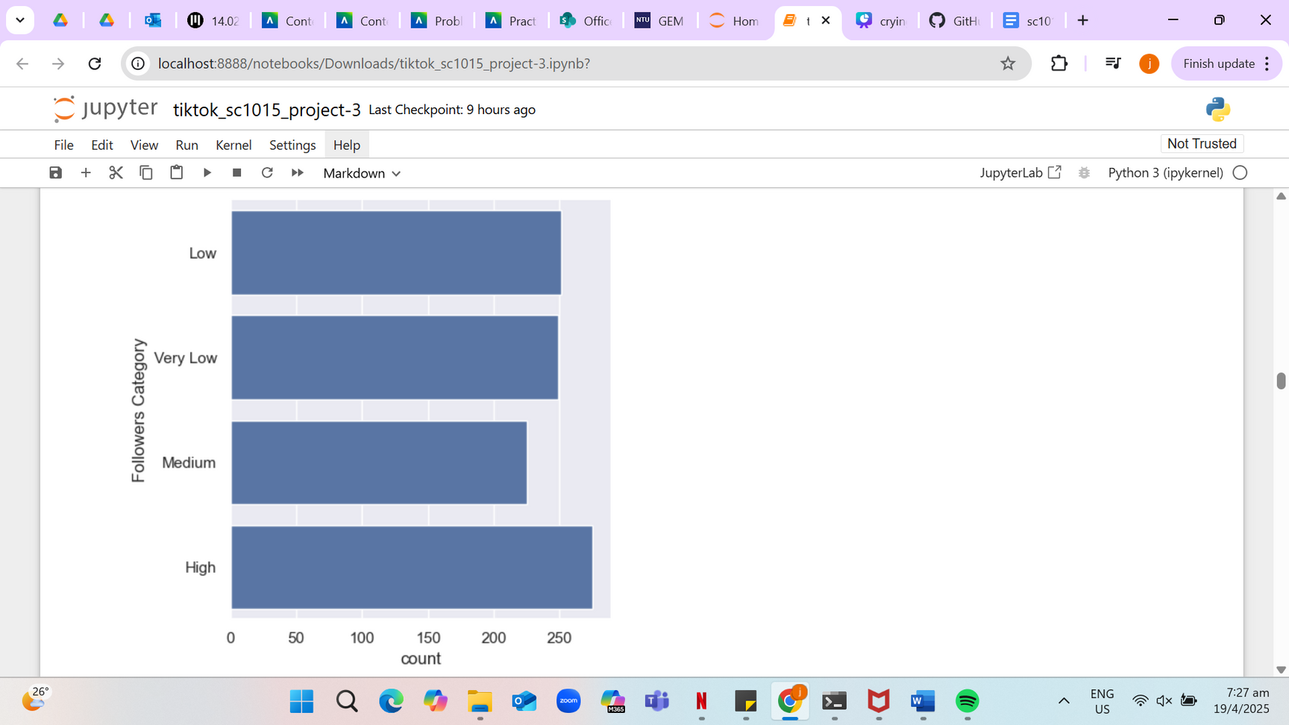
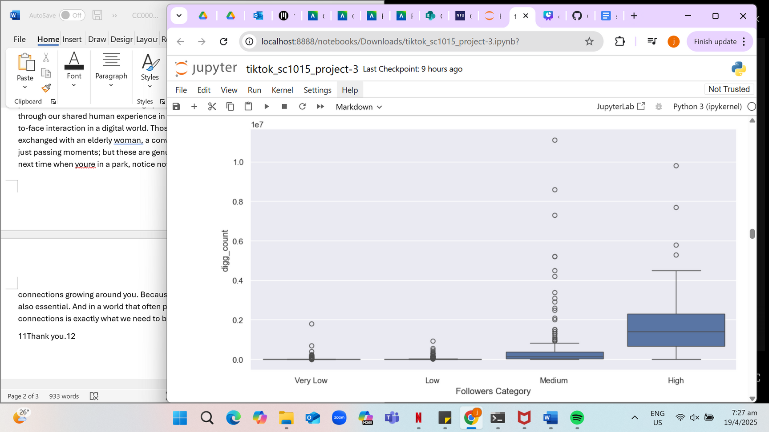
Number of posts by users for each follower category
digg_count against follower category
The number of posts made by each follower category is roughly the same.
Generally, as the followers category increases, the like count increases as well.
Statistical description

Slide 11
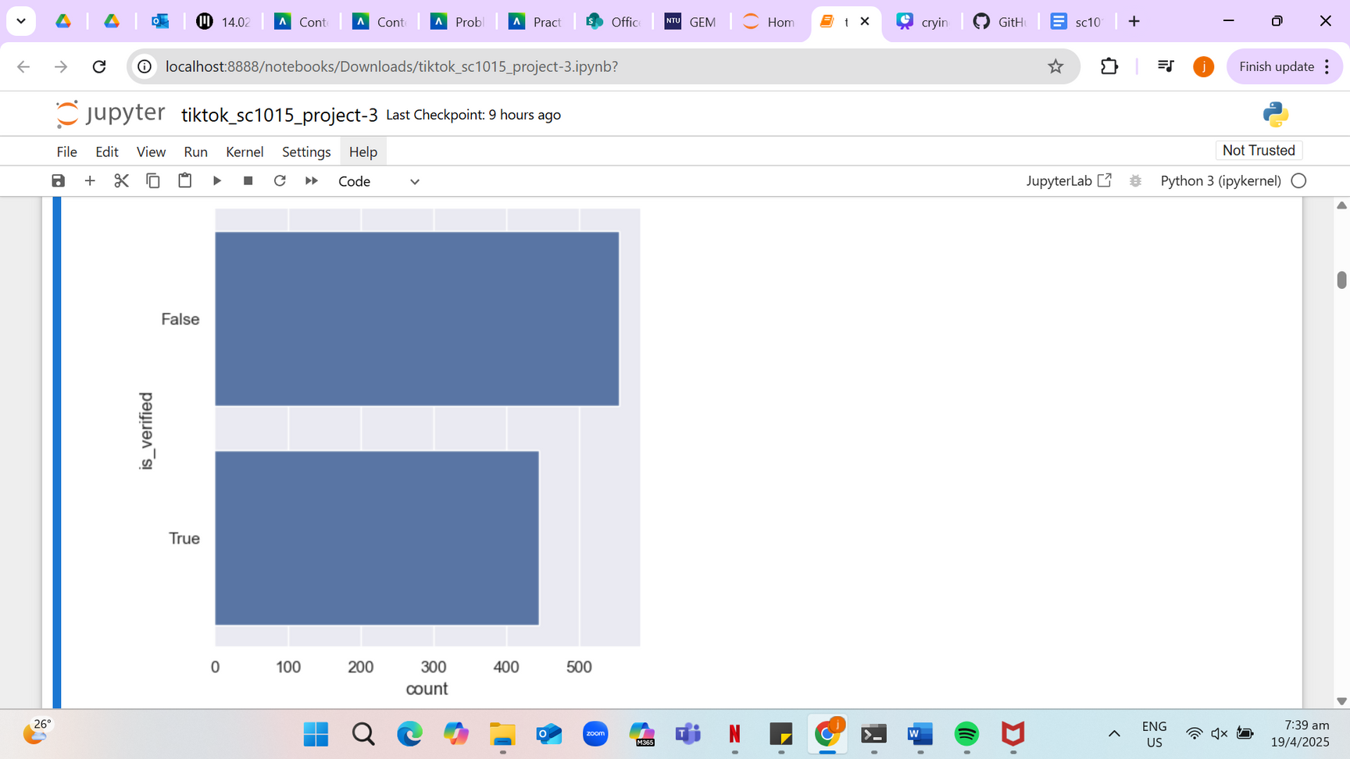
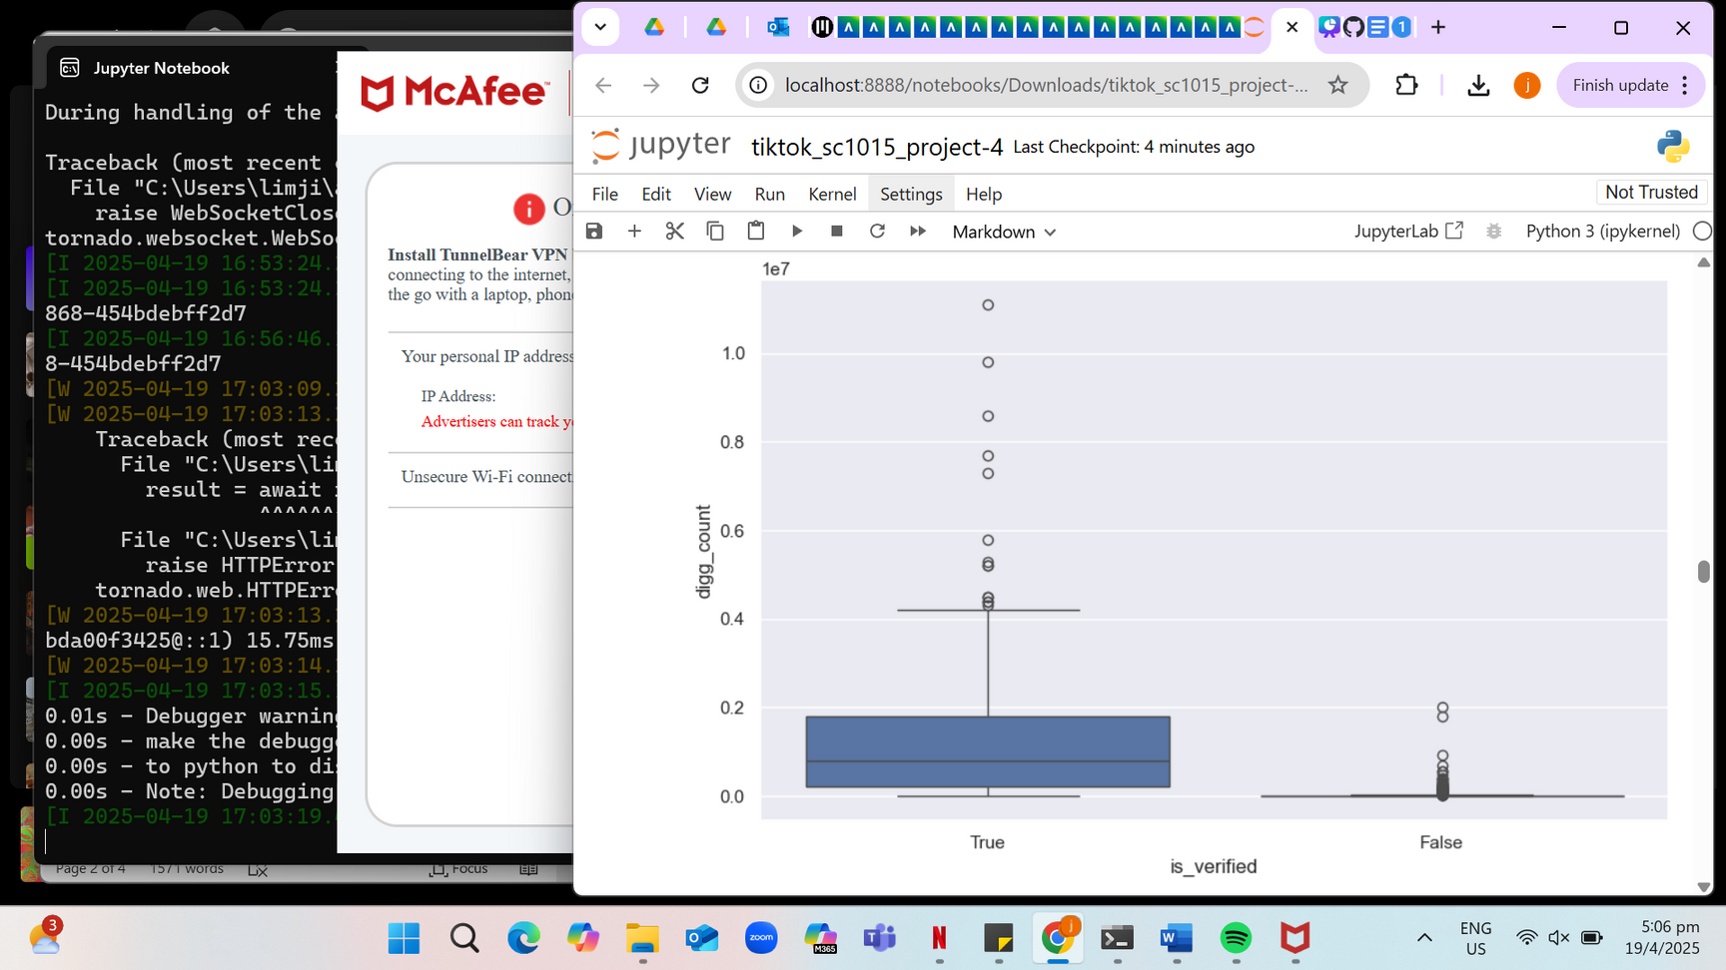
Number of posts by verified/non-verified accounts
digg_count against verified/non-verified accounts
Within a dataset with 1000 rows, the distribution is relatively even.
Verified accounts have significantly higher like counts compared to non-verified profiles
Statistical description

Slide 12

Data Cleaning
01
Handle missing values:
This ensures our model is accurate and improves model performance
02
Handle outliers:
Outliers are expected given the nature of social media with the presence of viral videos, so we do not remove them
03
Clean and transform variables:
Standardizing variable names with lowercase and underscores
Renaming of digg_count to like_count
04
Final data quality check:
Check for data types, and make sure there are no more missing or duplicate values left.
Data preparation

Slide 13

Machine Learning
Predictors:
play_count
profile_followers
video_duration
is_verified
weekday
Models used:
linear regression
decision tree
random forest
random forest (Increase depth and number)
random forest (GridSearchCV)
random forest (LogTransform)
Machine learning

Slide 14
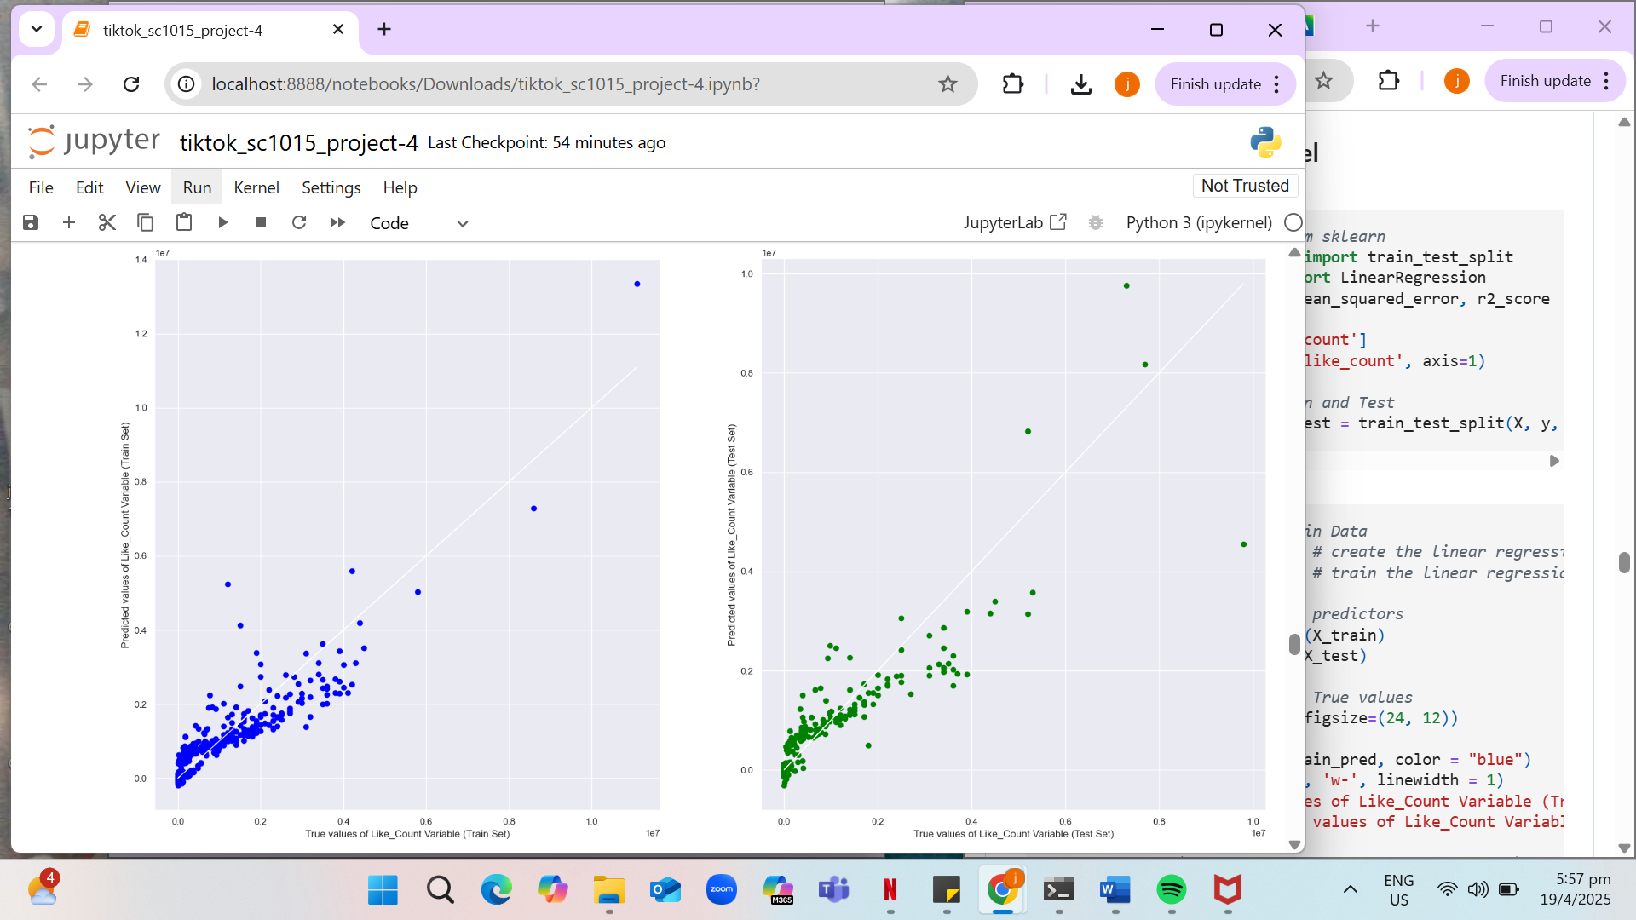
Linear regression
Train Dataset
R²: 0.840
Test Dataset
R²: 0.808
Machine learning

Slide 15
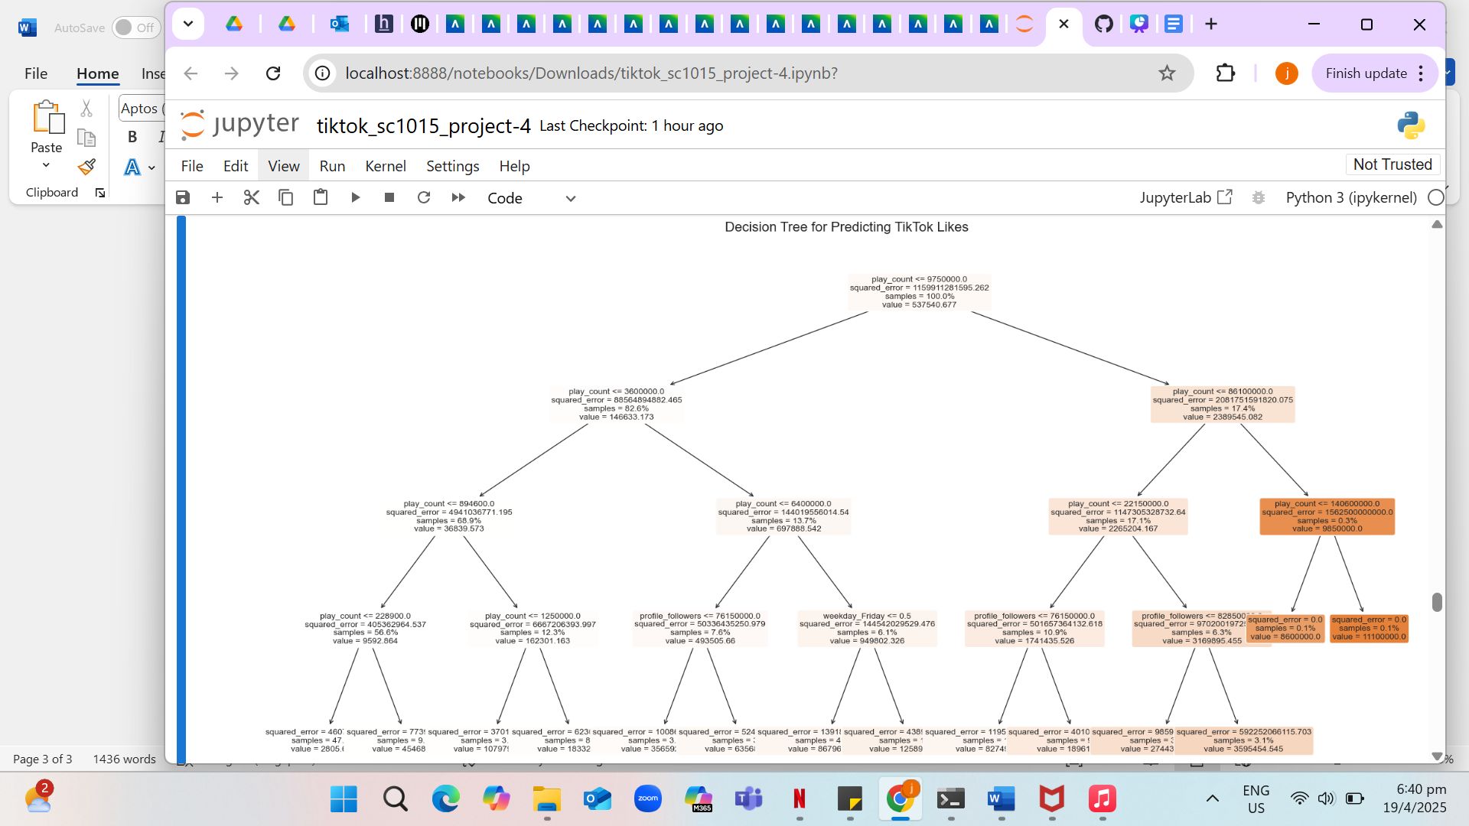
Decision tree
Train R²: 0.915
Test R²: 0.756
Machine learning

Slide 16
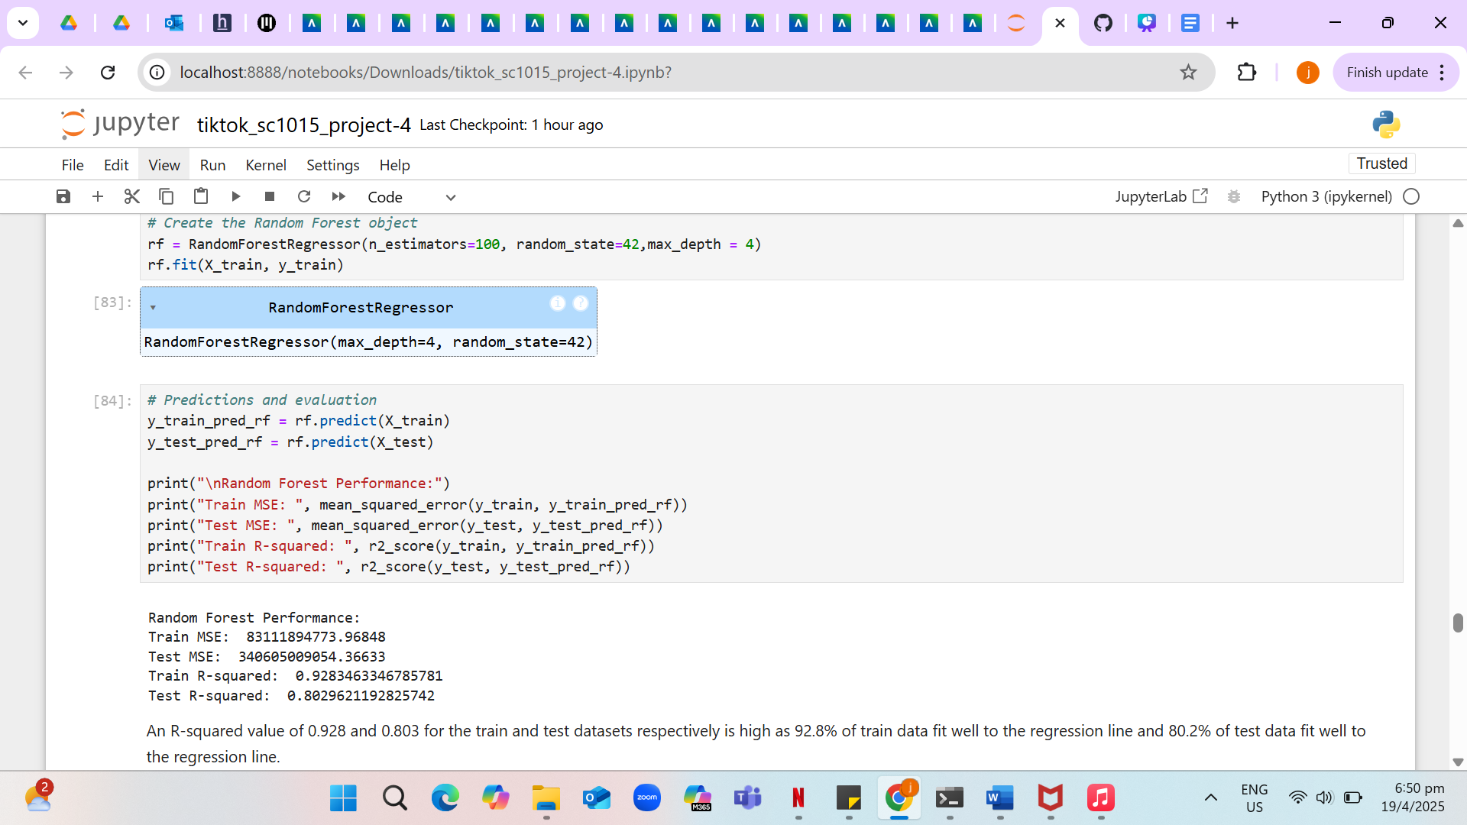
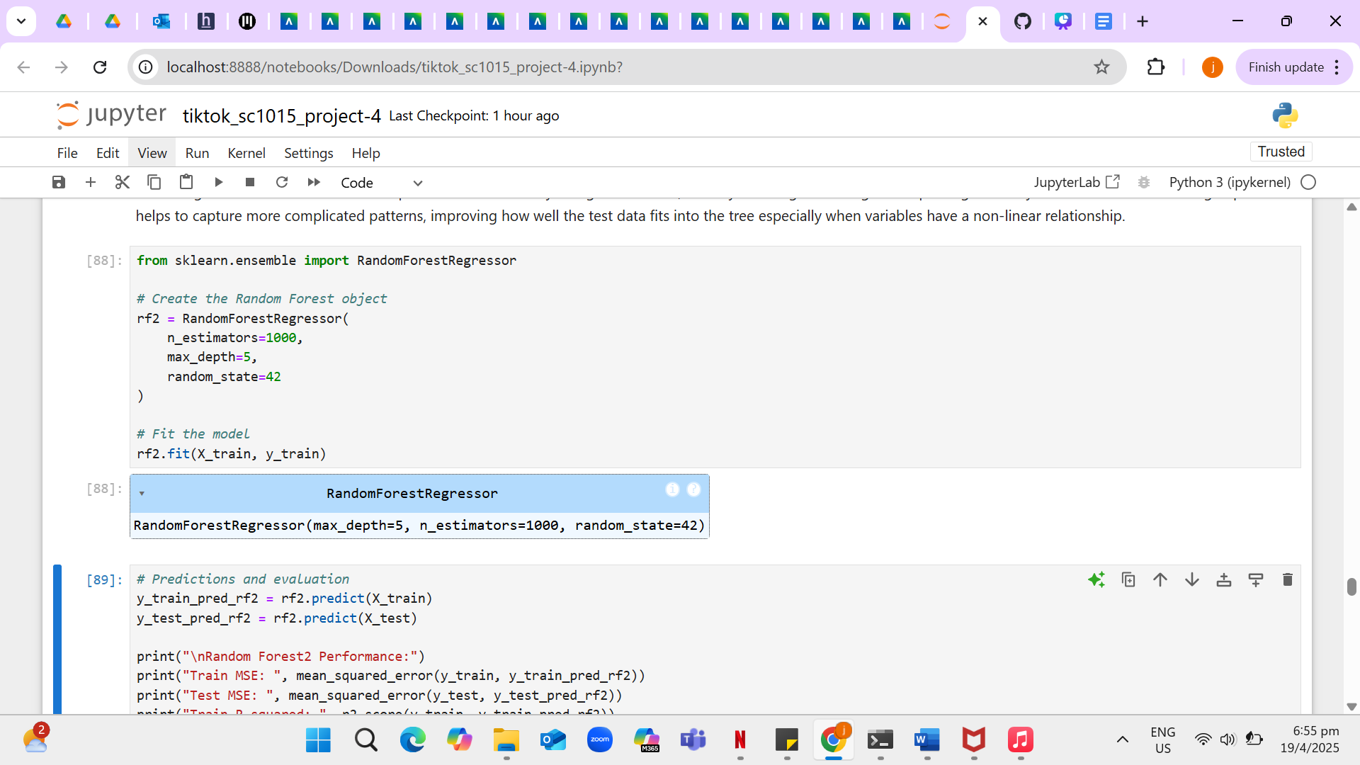
Random forest
Train R²: 0.928
Test R²: 0.803
Increase number and depth in decision tree
Train R²: 0.947 Test R²: 0.817
Machine learning

Slide 17
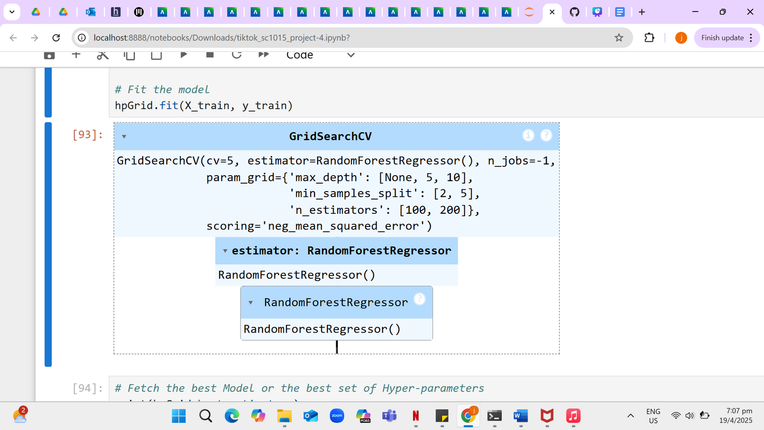
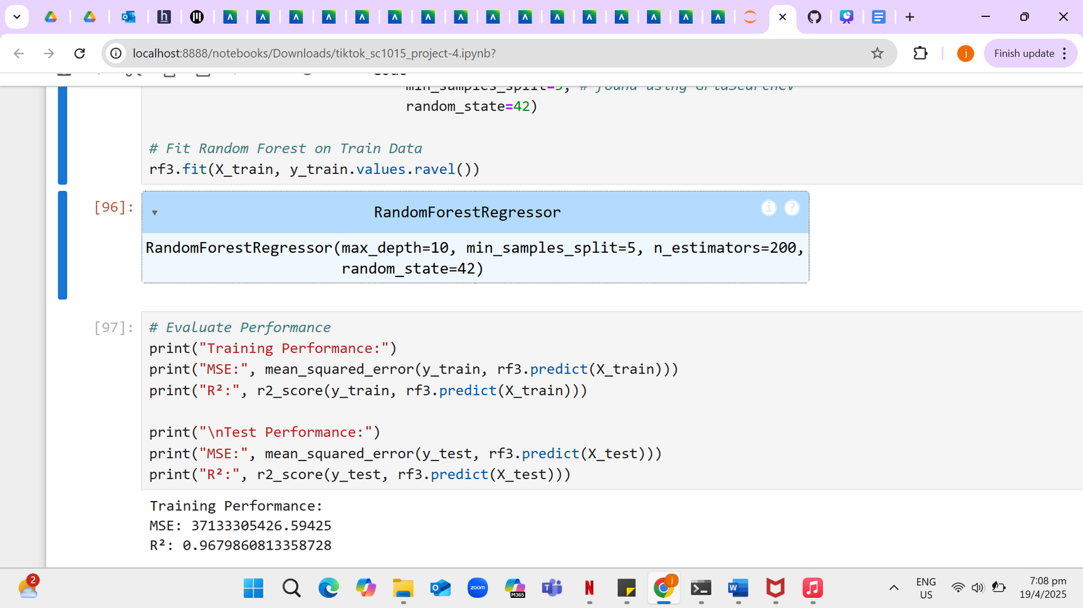
Random forest
GridSearch Cross Validation
Random forest through GridSearchCV
Train R²: 0.968
Test R²: 0.819
Machine learning

Slide 18
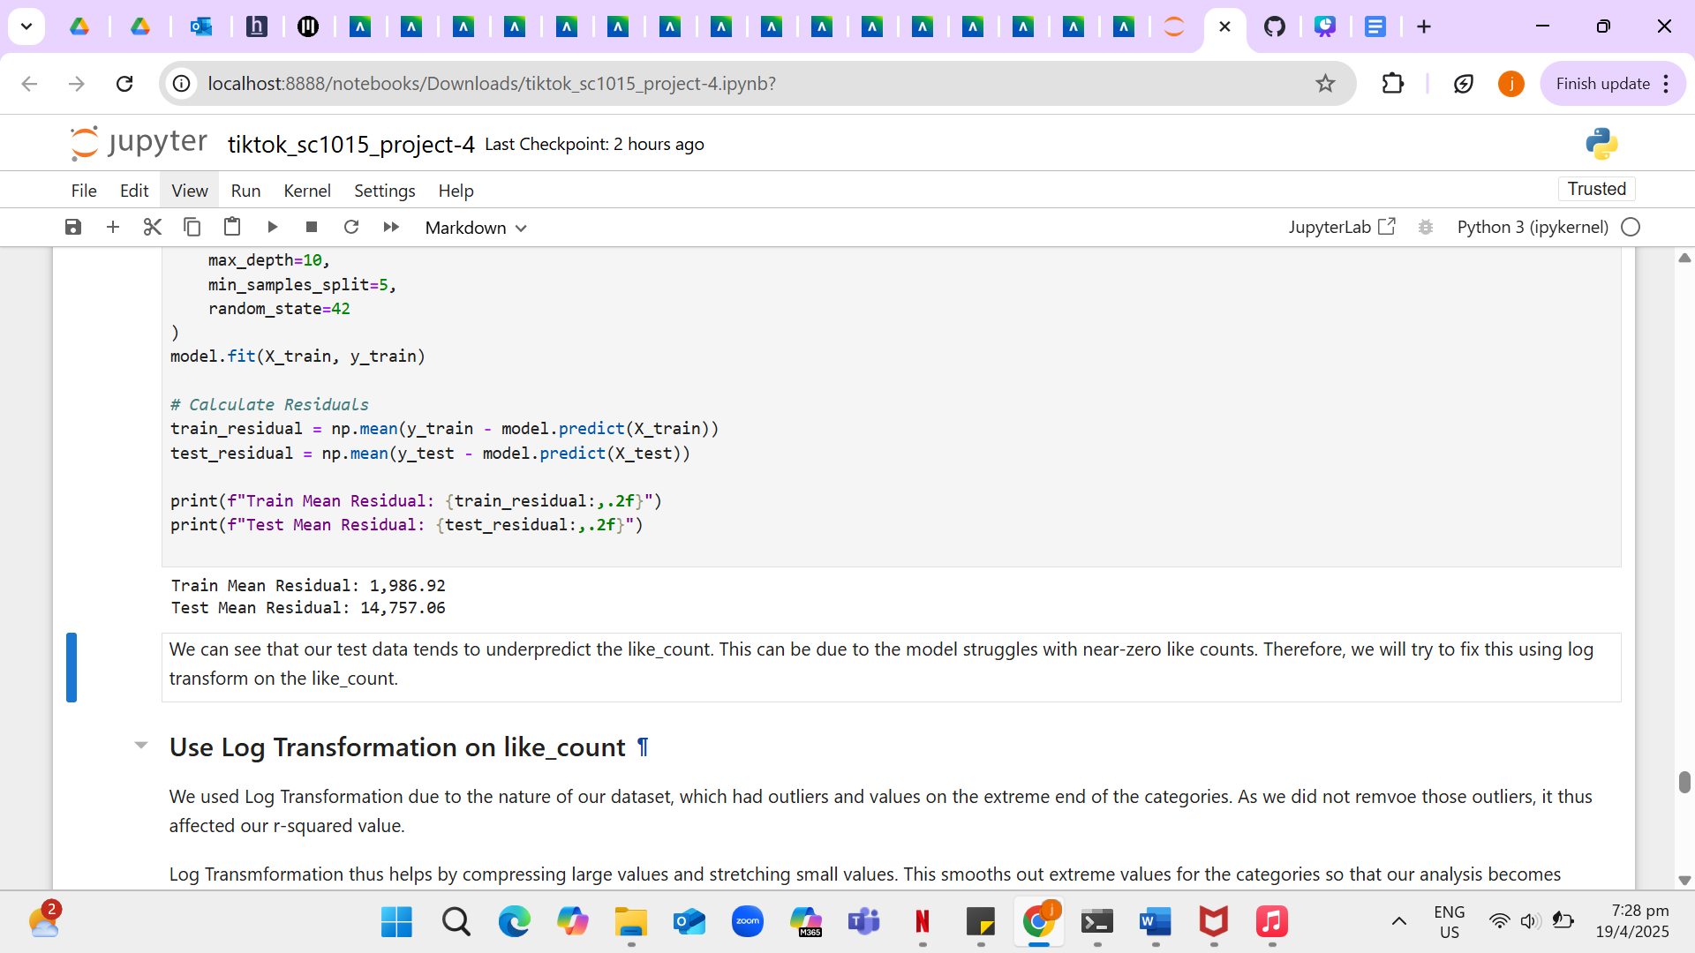
Random forest
Residual Analysis + Log Transformation
We first performed residual analysis to analyze how the model deviates from actual values.
Results show that test data tends to underpredict like count, hence we apply log transformation.
Log Transformation compresses large values and stretch out small values, smoothing out extreme values.
Train R²: 0.992
Test R²: 0.974
Machine learning

Slide 19
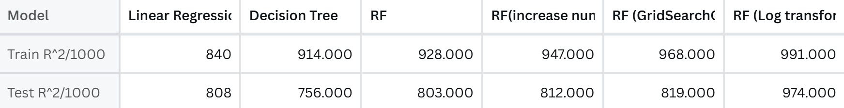
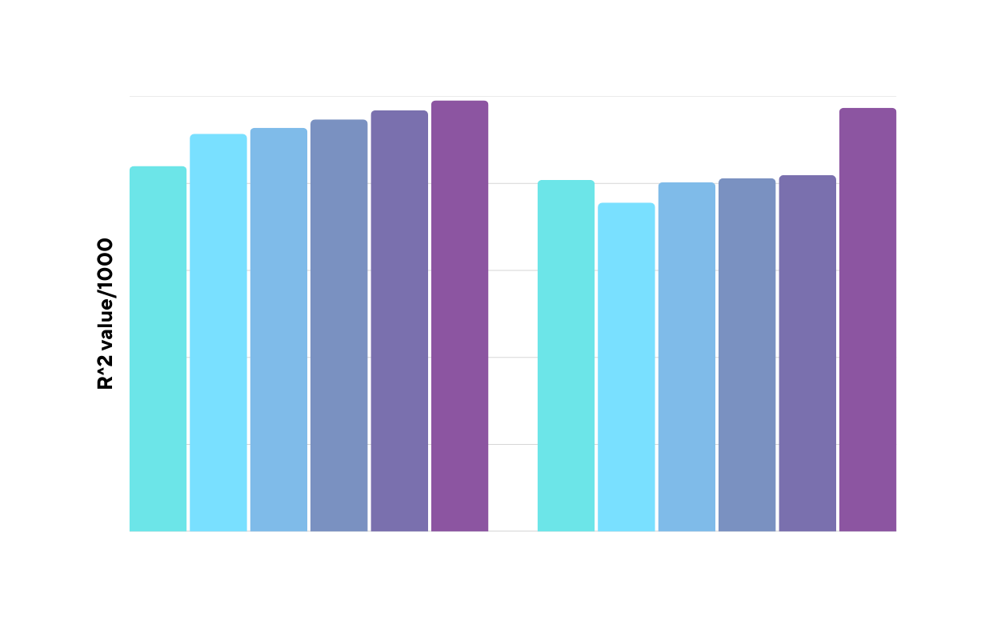
Model Performance
Algorithmic optimization
Train dataset
Test dataset

Slide 20
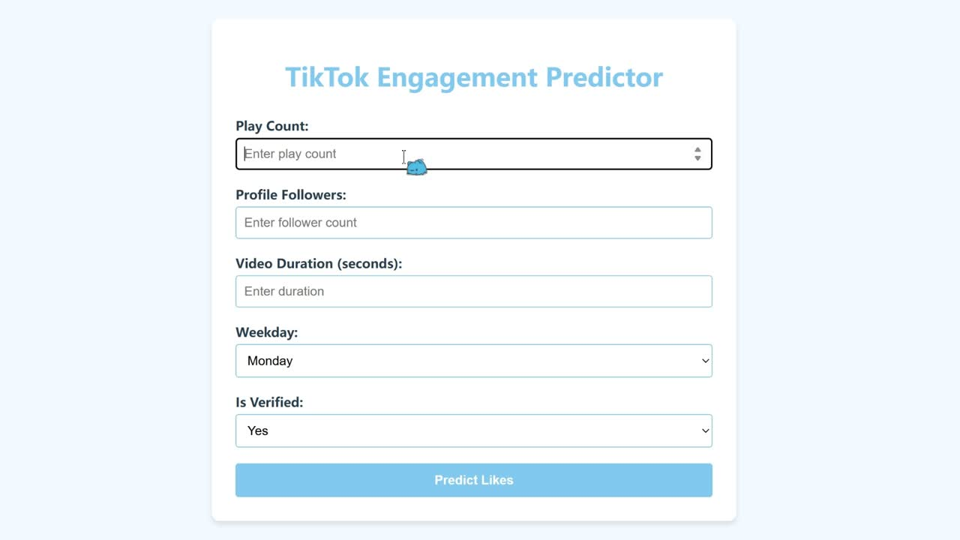
Machine learning

Slide 21
Outcome
Machine learning function: Random forest with log transformation
Helps companies predict the like counts of their Tiktok posts based on different variables
Intelligent Decision

Slide 22

What we learnt:
Interactive web features
Residual analysis
Log transformation
Intelligent Decision

Slide 23
Insights & Conclusion
Key insights on factors that affect engagement:
Best day to post: Post on the weekend when user activity is highest
Video duration: Tiktok videos between 12 and 17 seconds have the highest like counts
Follower Count: The higher the number of followers, the higher the engagement
Verified Account: Posts by verified accounts receive significantly higher likes
View count: Companies should focus on increasing exposure to increase engagement
Key suggestion: Paid promotions by celebrities or influencers for greater reach and engagement
Intelligent decision

Slide 24

Thank You

